Slide 1
Sample presentation Bank of Baroda Hackathon 2024
AI-Powered Chatbots and Virtual Assistants: Implement AI-driven chatbots and virtual assistants that handle real-time inquiries, provide accurate responses, and offer personalized recommendations.
Your Team Name : THE WICKED CREW
Your team bio :Our goal is to provide advanced technologies and creative solutions to enhance customer service experiences and streamline business operations.
Date : 30th June 2024

Slide 2
Problem Statement?
PROBLEM STATEMENT Design and develop AI-powered chatbots and virtual assistants capable of handling real-time inquiries, delivering accurate responses, and providing personalized recommendations to enhance user experience and efficiency across various applications and industries.
REASON WHY!? Enhance user experience with instant, accurate, and personalized responses. Automate customer inquiries, improving operational efficiency. Provide 24/7 availability and scalability for global reach. Offer personalized recommendations, boosting customer satisfaction and loyalty.

Slide 3
Pre-Requisite
Each of these products has their own cons such as cost and complexity for smaller business ,less seamlessness when integrated with non-google ecosystem, have steep learning curve for developers not familiar with the AWS service, open source it needs more in-house resource for setup customization and maintenance.
The competitive or alternative products for the problem are IBM Watson assistance , Google Dialog flow , Amazon Lex , Rasa.

Slide 4
Tools or resources For The Prototype
Google Analytics and Hotjar
Azure Bot Service
Azure Cognitive Services
Azure Machine Learning
Azure Logic Apps
Azure Functions
Azure Key Vault
Azure DevOps
Azure Monitor and Application Insights
Azure Cosmos DB or Azure SQL Database
Azure Security Center
Figma/Adobe XD for design and prototyping.
Postman and Selenium for API and UI testing.

Slide 5
Any Supporting Functional Documents
Methodology
Implementation
Architecture
Architecture is User interfaces provide support across all kind of multiple channels.
First of all the requirement gathering by stakeholder interview and customer feedback for the need of the chatbot, Then the required system arrangements and evaluation of the available systems.
Integration layers to integrate chatbot with CRM systems.
Data layer to store customer data and interaction history secure data transmission and storage with encryption.
Security layer - roll based control of tools to ensure data privacy.
AI layer to implement NPL ,sentiment analysis, translation and speech recognitions.
Next is the solution design defining the feature and functionalities needed for the project like NPL, integration needs and security requirements. secondly the vendor selection.
Lastly, budget planning for setup cost, development, Testing and employment.
Implementation of the project is setting up the chosen chatbot development platform.
Next is AI integration for developing and training the model for NPL.
Third is data integration that is integrating the chatbot with the CRM system to sync data from existing databases.

Slide 6
Key Differentiators & Adoption Plan
Proactive Monitoring
Seamless Ecosystem
Tailored Solutions
Enhanced UX/UI
Continuous Improvement
Data Protection
Targeted Marketing and Outreach
Strategic Partnerships
Customer Onboarding and Training
Demonstrating Value
Continuous Engagement and Feedback
Key Differentiators
Adoption Plan

Slide 7
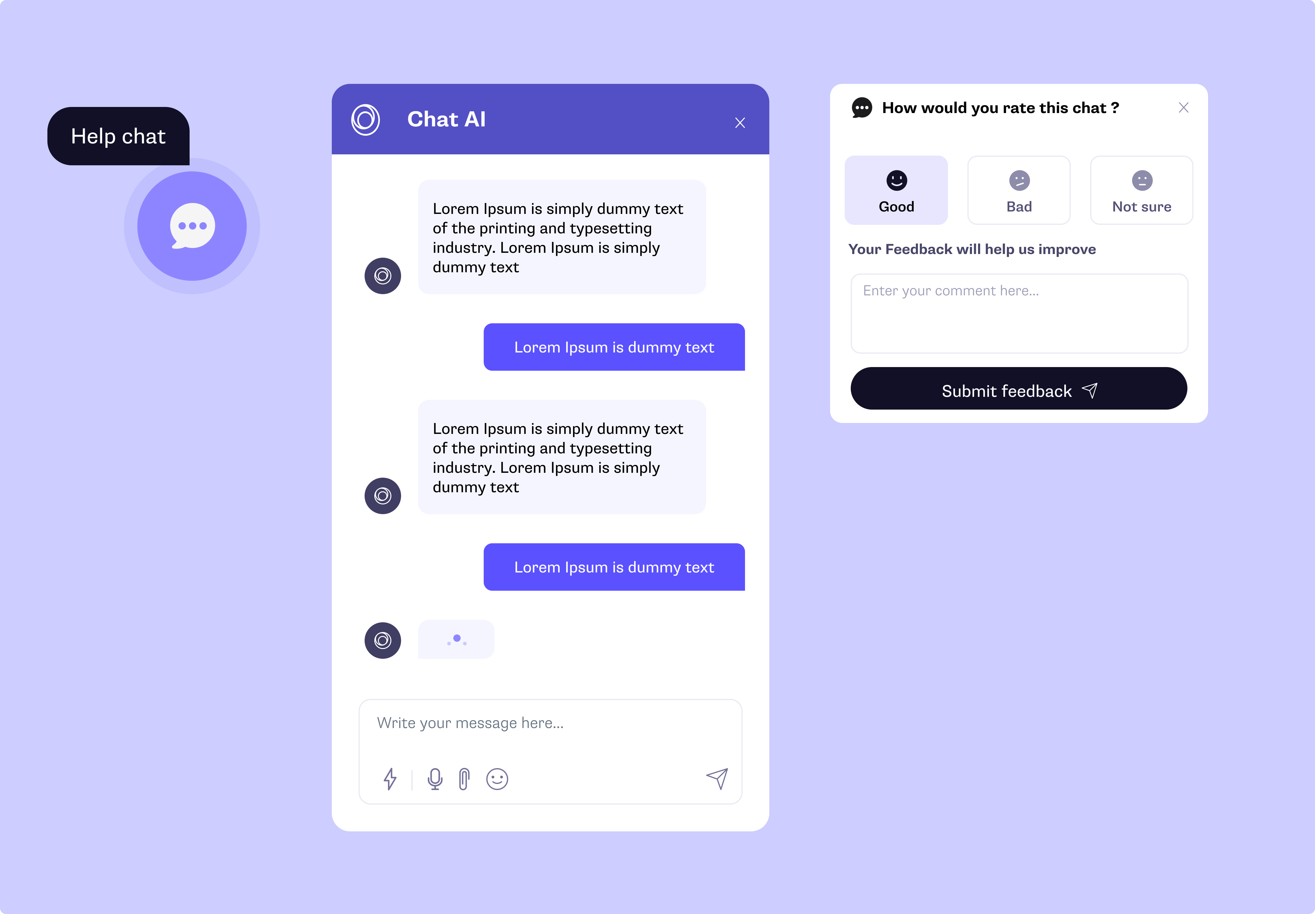
Wireframe of the chatbot

Slide 8
Business Potential and Relevance
Offering personalized financial advice and product recommendations based on user profiles and financial goals.
Quickly handling common inquiries, freeing up human agents to focus on more complex issues.
Banking and Financial Services
Customer Service and Support
Helping customers with account inquiries, transactions, and loan applications.
Providing 24/7 Assistance customer service, reducing wait times, and improving customer satisfaction.

Slide 9
Uniqueness of Approach and Solution
High Customizability and Flexibility,Robust Security and Compliance, Predictive Assistance
Continuous Improvement and Adaptability, Comprehensive Support and Maintenance
The Solution is AI-Powered Chatbots and Virtual Assistants: Implement AI-driven chatbots and virtual assistants that handle real-time inquiries, provide accurate responses, and offer personalized recommendations.

Slide 10
User Experience
Personalized Interactions
Intuitive User Interface
Instant and Accurate Responses
Continuous Improvement
Proactive Assistance
Omnichannel Support
Security and Trust
Enhanced Accessibility

Slide 11
Scalability
Built on Azure’s Scalable Infrastructure
Microservices Architecture
Load Balancing and Caching
Continuous Monitoring and Autoscaling
Database Scalability
Performance Optimization Techniques
Continuous Deployment and Updates

Slide 12
Ease of Deployment and Maintenance
Since we are using Microsoft Azure AI it has established platform for integrated services for seamless quick deployment and updates of the chatbot.
Azure logic apps and API management for direct integration witha the CRM system.
Automated monitoring by Azure monitor for real time tracking and alerts.security centre for continuous assessment, every update and patch are automated.
Scalability of the product can also be automated on par with the demand.
manual intervention is also reduced by using Azure active directory for data management.

Slide 13
Security Considerations
Encryption of transit and rest data.
Secure access of the data authentication and authorization of the access to the database collection.
Collecting only necessary details, allowing users to access, correct and delete details upon request and regular security assessments.
For Application security review code regularly, Use API security with keys and IP whitelisting
Infrastructural security using firewalls, monitor security baseline and by regularly updating and patching components.
Monitoring and Incident response , real time monitoring of the accessions, analyze log data and automated alerts.
Anonymize the user data when not in use and convey privacy policy to the customers clearly
Protect user interaction, mask sensitive information in log during processing, to prevent unauthorized exposure.

Slide 14
Thank You
Team member names:
Annapoorani A
Suhail Ahmad T
Srivarshan V M
Ajitha Anandhi J

